Slide 1

19CSE212 AVL Trees
Ms.Jyotsna , Ms.Nalini Sampath
Department of CSE
Amrita School of Engineering

Slide 2
AVL TREE
Named after Adelson-Velskii and Landis
AVL Tree is a height balanced binary search tree where the difference between heights of left and right subtrees cannot be more than one for all nodes.
This difference is called the Balance Factor.
Every sub tree is an AVL tree.
Balanced Tree –
Depth = O(log N)
Time for searching,insertion and deletion = O(log N)
Every node must have left and right sub-trees of the same height.

Slide 3
AVL Tree features
In AVL Tree ,every node maintains an extra information known as balance factor.
The balance factor of every node is either -1,0 or +1.
Every AVL Tree is a binary search tree but every Binary Search Tree need not be an AVL tree.
Balance Factor = height(left subtree) – height (right subtree)
If the difference in the height of left and right sub tree is more than 1, the tree is balanced using some rotation techniques.

Slide 4
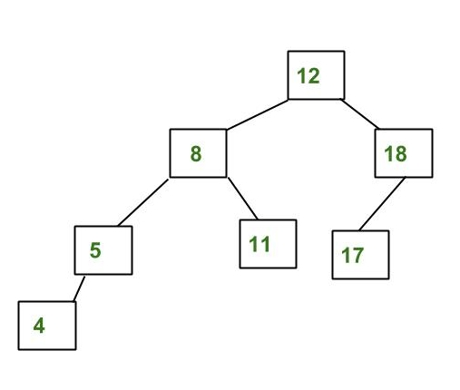
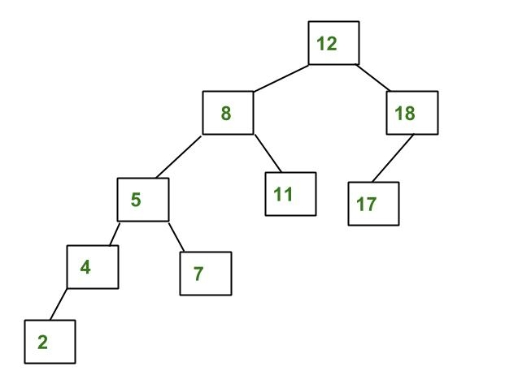
AVL Tree?

Slide 5
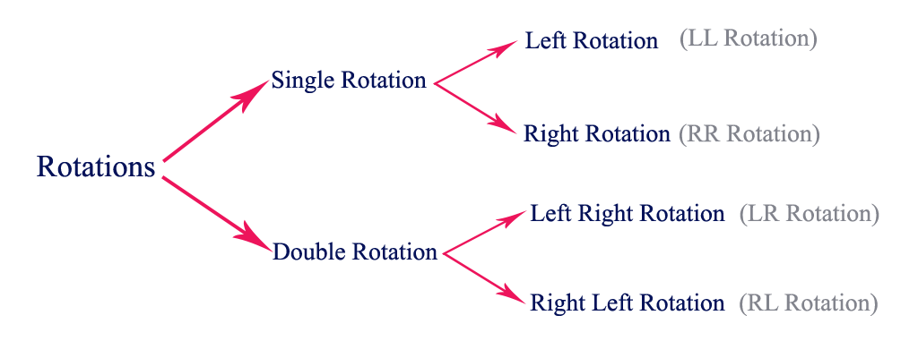
Operations on AVL Tree
Insertion
Deletion
Rotation
Search

Slide 6
Insertion Operation in AVL Tree
In an AVL tree, the insertion operation is performed with O(log n) time complexity. In AVL Tree, a new node is always inserted as a leaf node. The insertion operation is performed as follows...
Step 1 - Insert the new element into the tree using Binary Search Tree insertion logic.
Step 2 - After insertion, check the Balance Factor of every node.
Step 3 - If the Balance Factor of every node is 0 or 1 or -1 then go for next operation.
Step 4 - If the Balance Factor of any node is other than 0 or 1 or -1 then that tree is said to be imbalanced. In this case, perform suitable Rotation to make it balanced and go for next operation.

Slide 7
Deletion Operation in AVL Tree
Deleting a node from an AVL tree is similar to that in a binary search tree. Deletion may disturb the balance factor of an AVL tree and therefore the tree needs to be rebalanced in order to maintain the AVLness.
If the node which is to be deleted is present in the left sub-tree of the critical node, then L rotation needs to be applied else if, the node which is to be deleted is present in the right sub-tree of the critical node, the R rotation will be applied.

Slide 8
AVL Rotations
We perform rotation in AVL tree only in case if Balance Factor is other than -1, 0, and 1. There are basically four types of rotations which are as follows:
L L rotation: Inserted node is in the left subtree of left subtree of A
R R rotation : Inserted node is in the right subtree of right subtree of A
L R rotation : Inserted node is in the right subtree of left subtree of A
R L rotation : Inserted node is in the left subtree of right subtree of A
Where node A is the node whose balance Factor is other than -1, 0, 1.

Slide 9
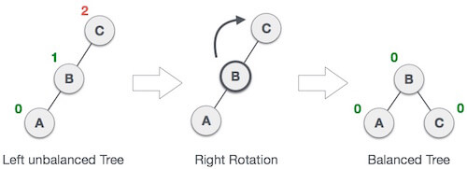
LL Rotation

Slide 10
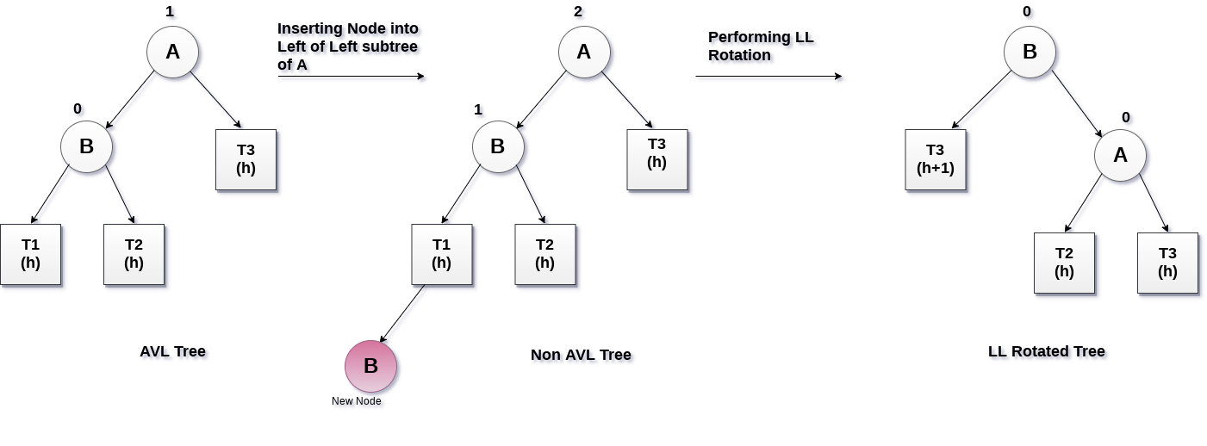
LL Rotation

Slide 11
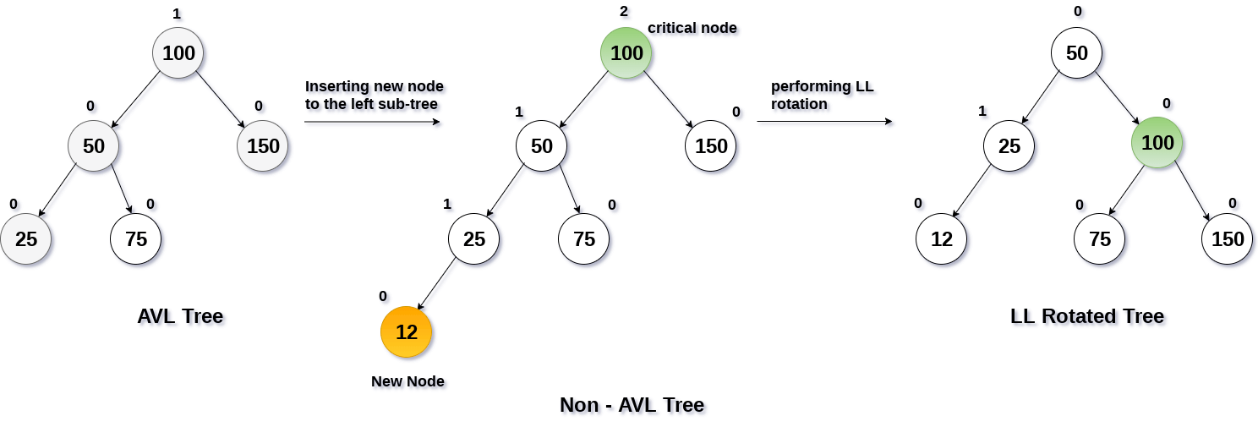
LL Rotation

Slide 12
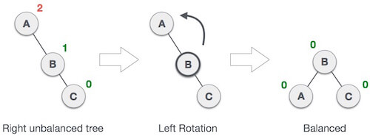
RR Rotation

Slide 13
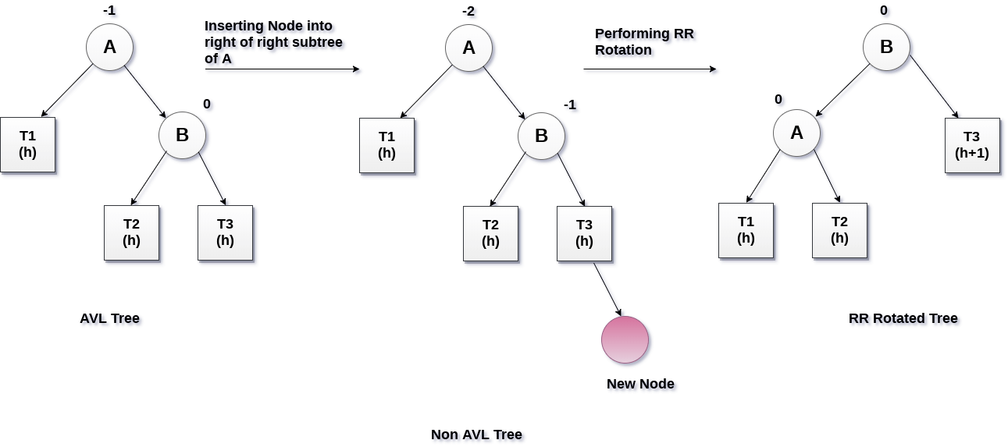
RR Rotation

Slide 14
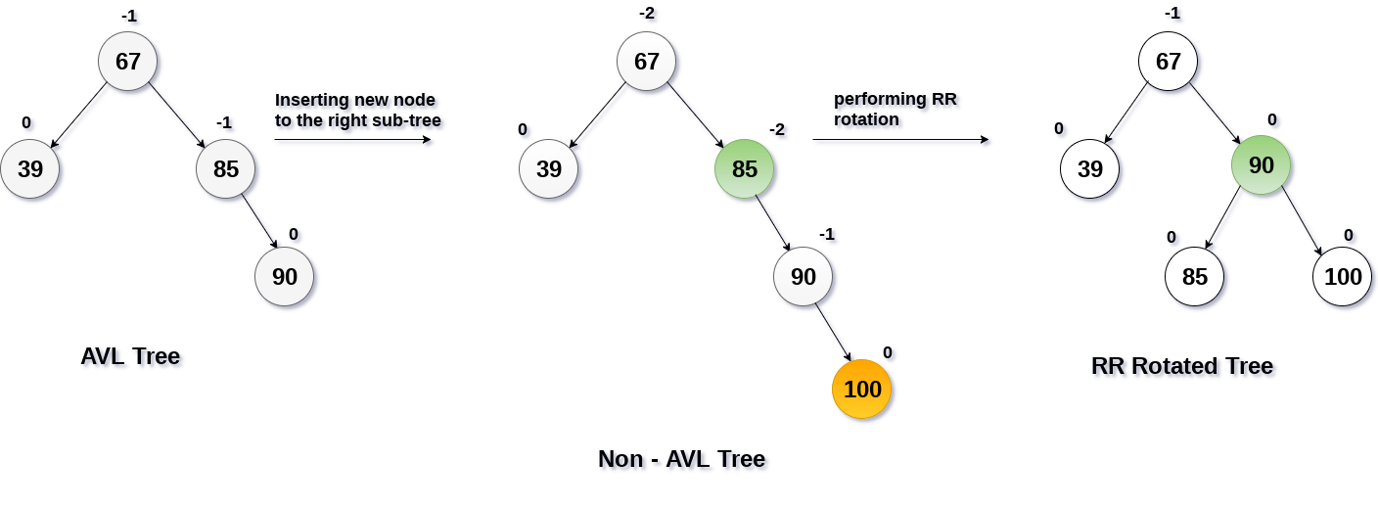
RR Rotation

Slide 15

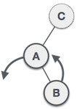
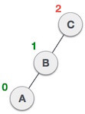
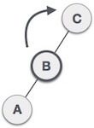
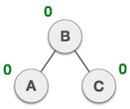
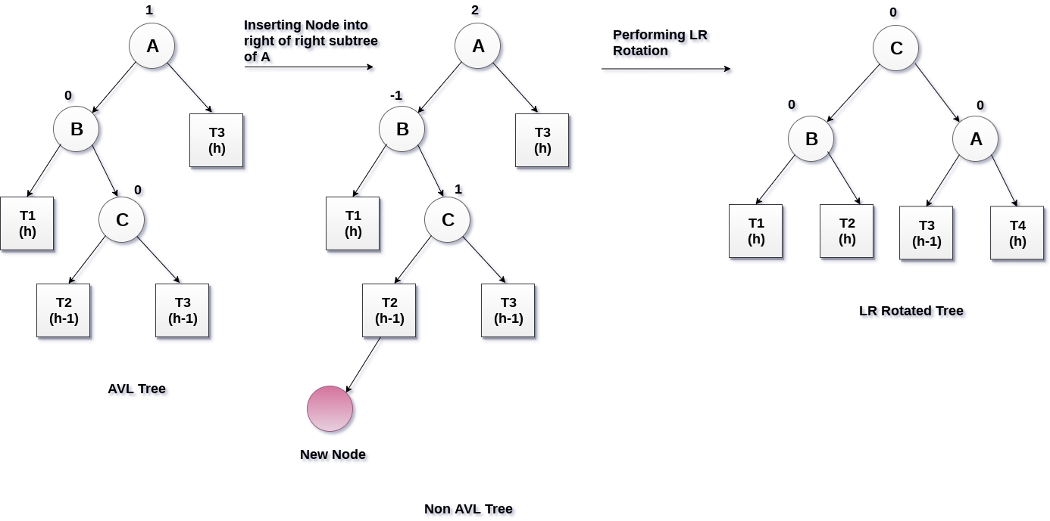
LR Rotation

Slide 16
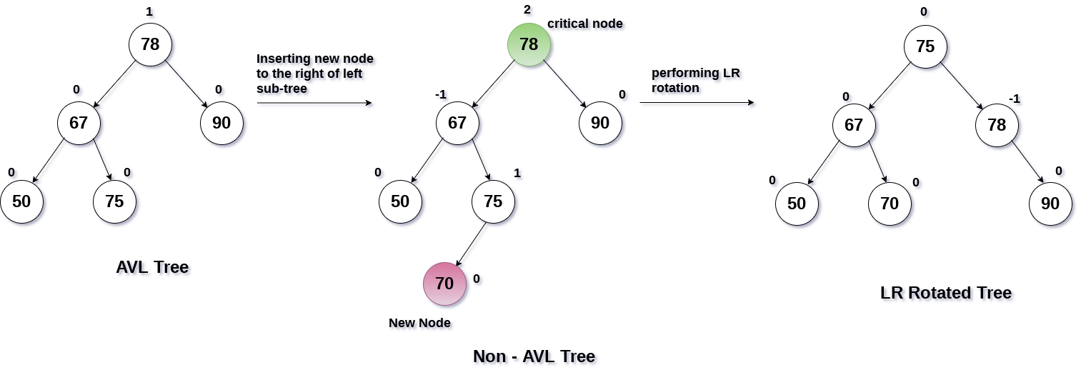
LR Rotation

Slide 17
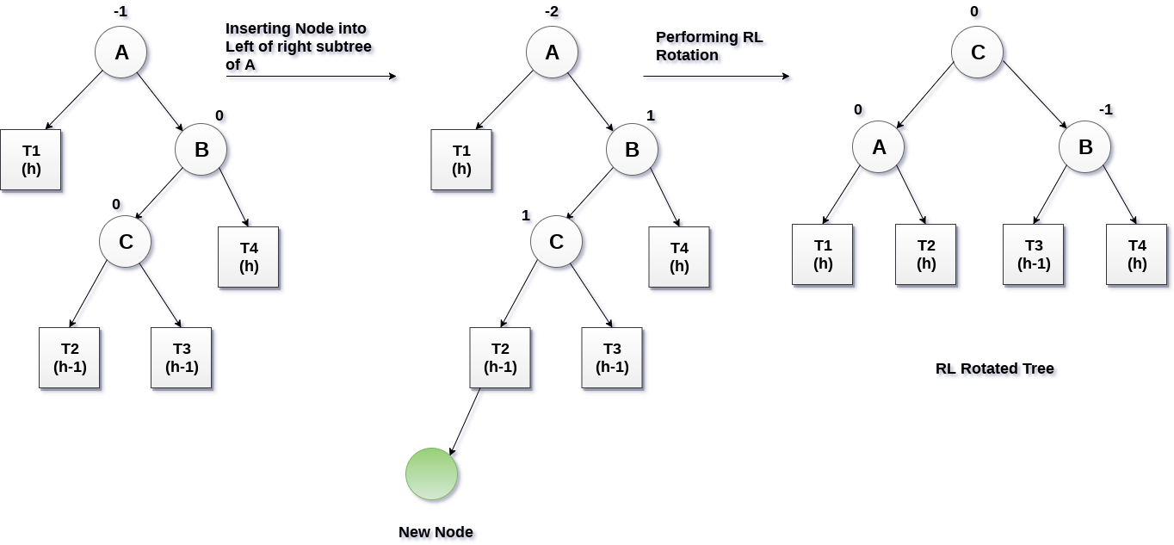
RL Rotation

Slide 18
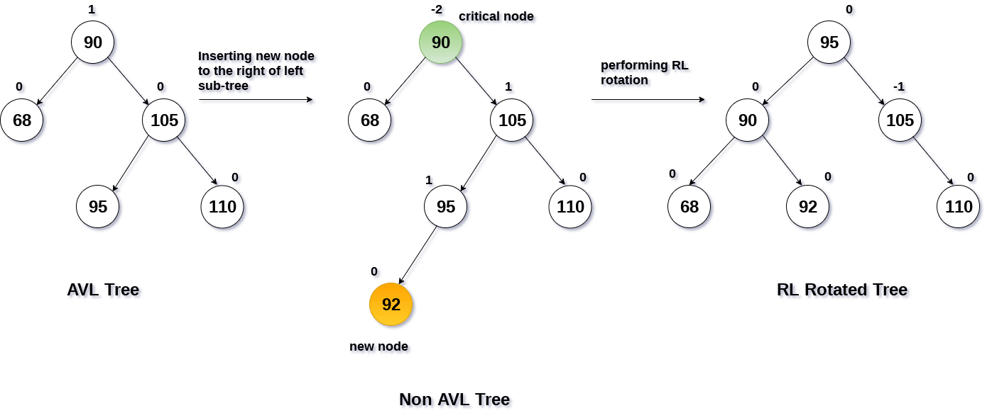
RL Rotation

Slide 19
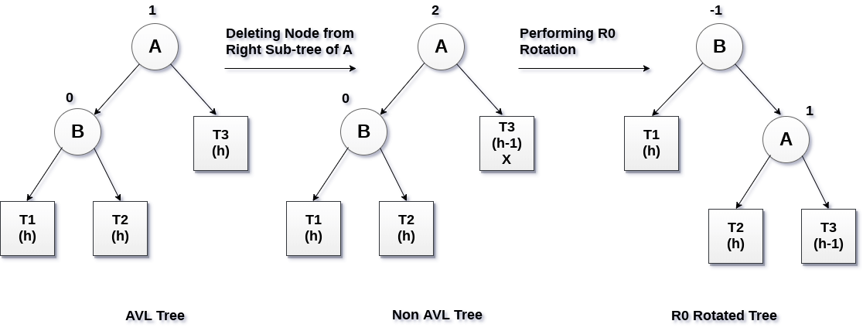
AVL Tree Deletion R0 rotation (Node B has balance factor 0 )

Slide 20
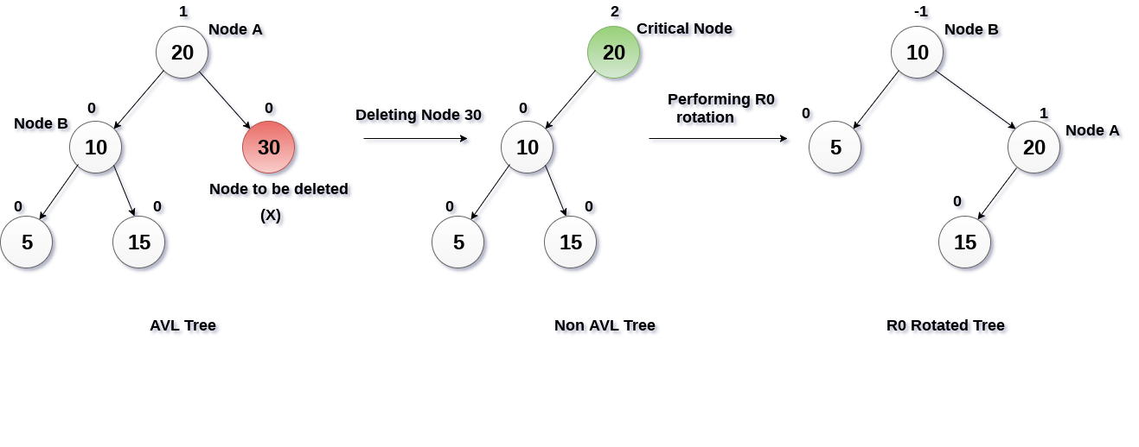
Delete node 30 ,which has a balance factor 0

Slide 21
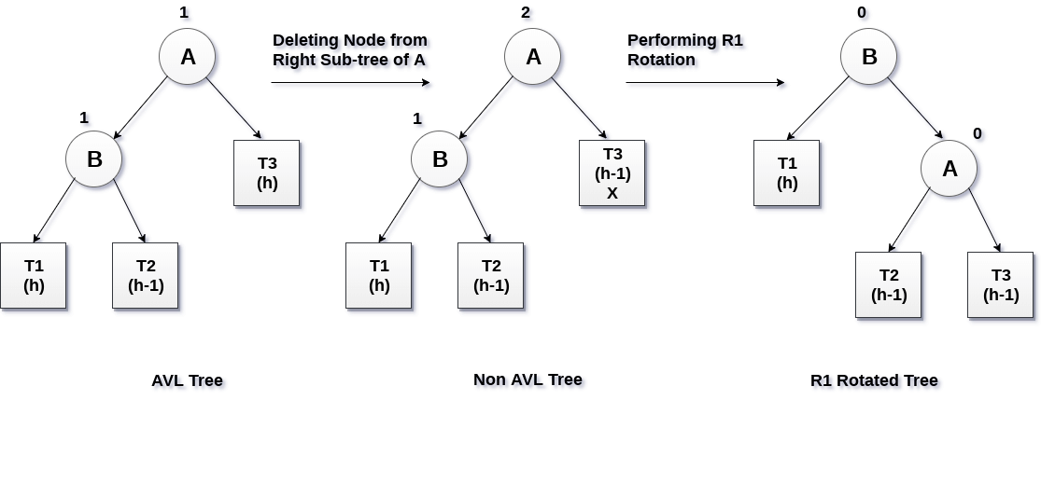
R1 Rotation (Node B has balance factor 1)

Slide 22
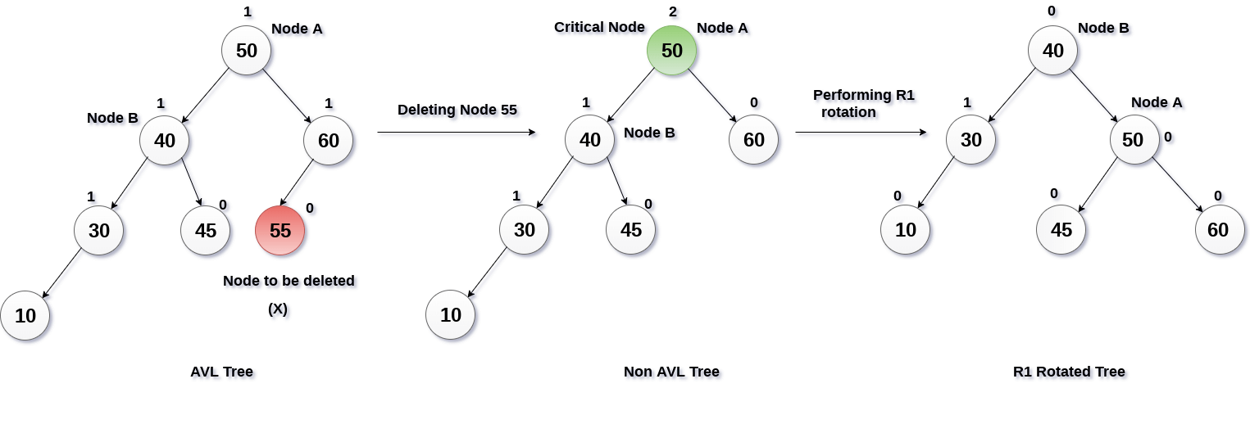
Delete node 55

Slide 23
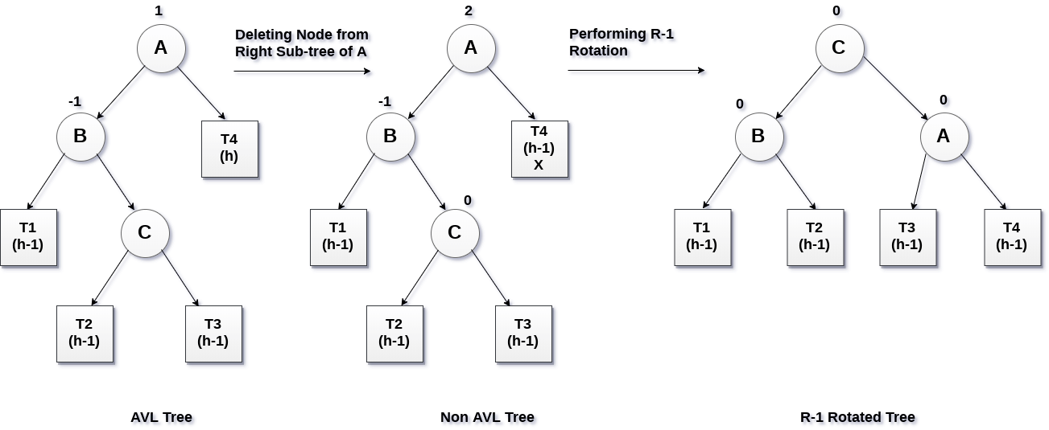
R -1 Rotation (Node B has Balance factor -1)

Slide 24
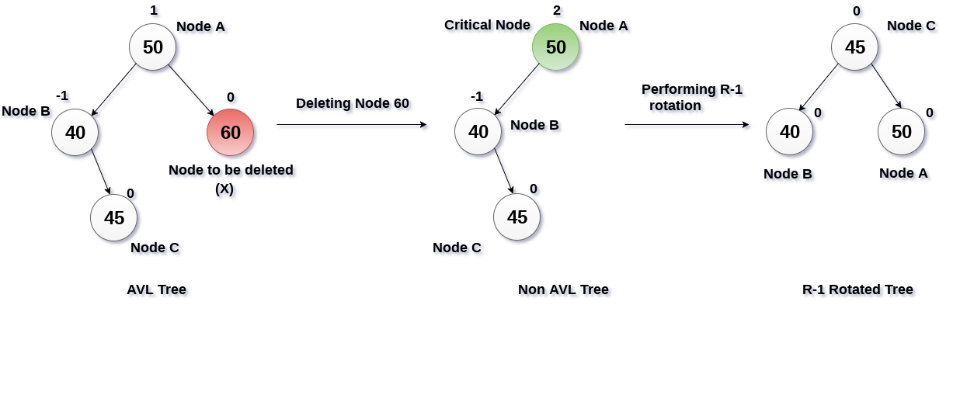
Delete node 60

